Slide 1
Promotion and Tenure
Purdue
Faculty
October 15, 2013
S. Laurel Weldon Vice Provost for Faculty Affairs (Interim)

Slide 2

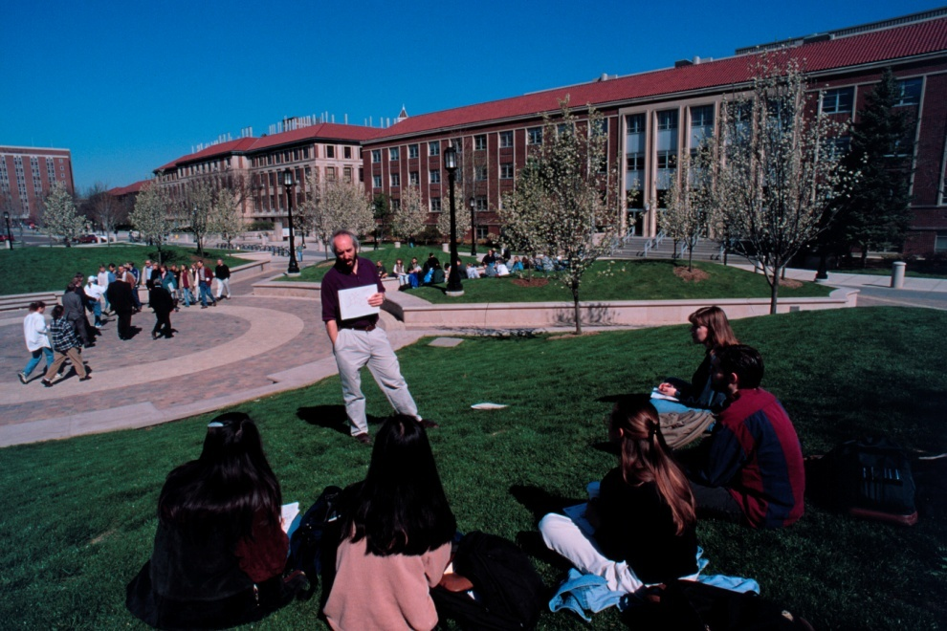

Purdue faculty by rank
 | Tenure Track Faculty | Clinical Faculty
Total | 1,807 | 121
Assistant | 352 | 71
Associate | 556 | 36
Full | 755 | 14
Deans and DHs | 144
Notes:
We have about 2000 faculty, with about 100 of these being clinical faculty

Slide 3
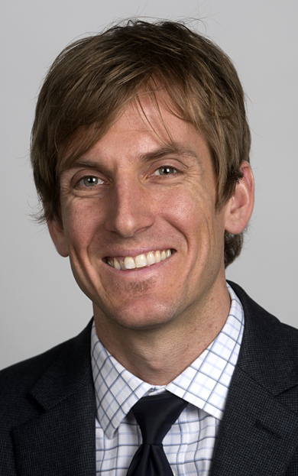
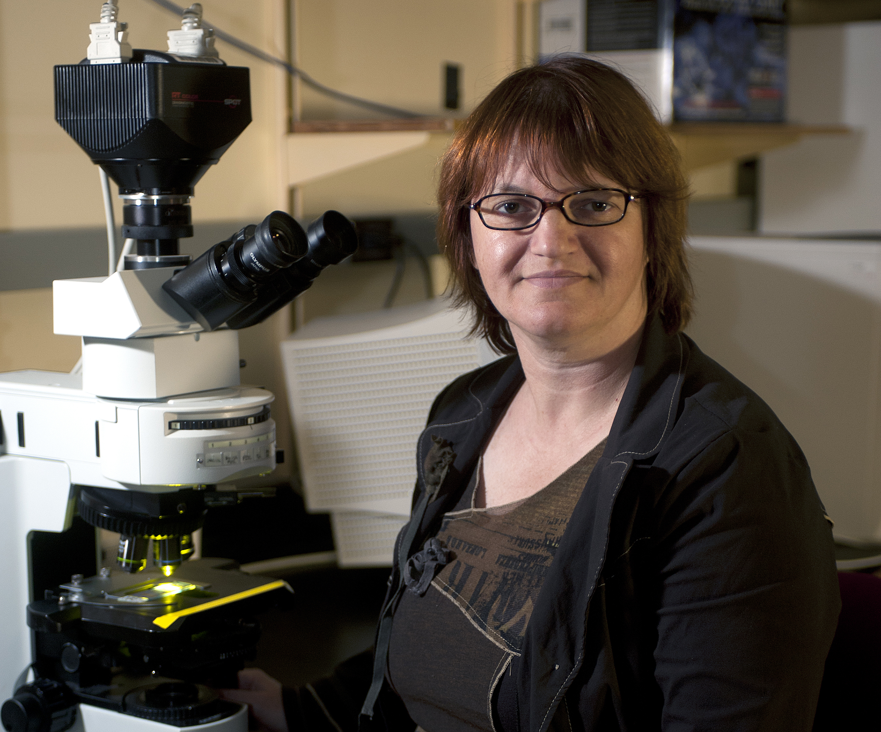

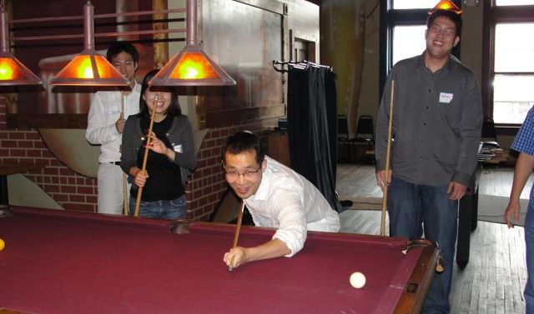
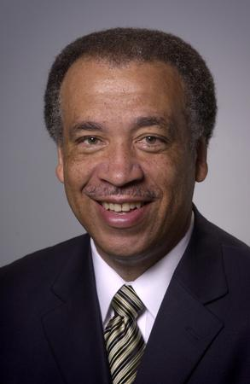
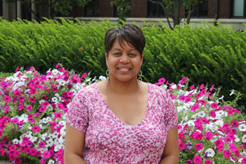
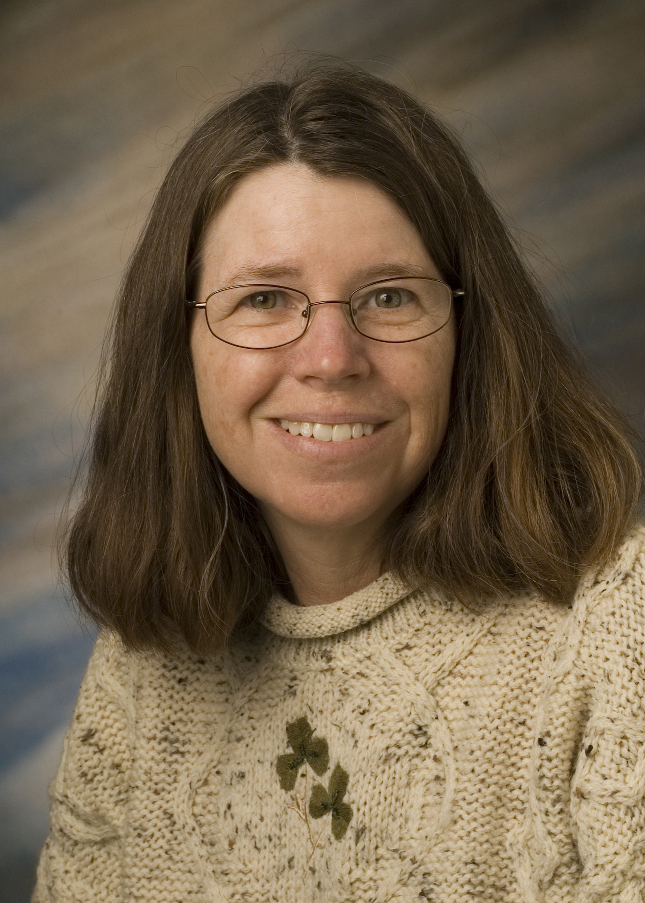
Purdue Tenure-Track Faculty by Rank 2012-13
Notes:
Big 10 Faculty
among the best in the world.
nation’s most “formidable intellectual capital”
With Big 10 peers produce 1/3 of nation’s Ph.D.s and garner more research $$ than Ivies or West Coast taken together
Purdue Faculty:
Over 2000 faculty members generate more than 70% of the
student credit hours and over half a billion dollars in research
expenditures
they come from all over the world; more than 2/3 are American born
most educated in the U.S. usually at the most prestigious universities.
nearly three fourths are male.
27% women and 7% URM.

Slide 4
Tenure-Track Faculty 2012-13
Notes:
Big 10 Faculty
among the best in the world.
nation’s most “formidable intellectual capital”
With Big 10 peers produce 1/3 of nation’s Ph.D.s and garner more research $$ than Ivies or West Coast taken together
Purdue Faculty:
Over 2000 faculty members generate more than 70% of the
student credit hours and over half a billion dollars in research
expenditures
they come from all over the world; more than 2/3 are American born
most educated in the U.S. usually at the most prestigious universities.
nearly three fourths are male.
27% women and 7% URM.

Slide 5
Promotion and Tenure
One of the strongest predictors of pre-tenure faculty satisfaction and success is understanding the promotion and tenure process.
At Purdue, the process is described in Executive Memorandum B-48, Section II and in Provost’s Letter
http://www.purdue.edu/provost/faculty/promotion.html
An updated Promotion and Tenure Policy is under development.

Slide 6
Tenure at Purdue
“…to be considered for promotion, a faculty member should have demonstrated excellence and scholarly productivity in at least one of these areas. Ordinarily, strength should be manifest in more than one of these areas.”
Learning (teaching)
Engagement (dept., profession, university, community, state, world)
Discovery (research)

Slide 7
Tenure at Purdue
To receive tenure, “a successful candidate should have a significant record of accomplishment as a faculty member and show promise of continued professional growth and recognition.”
Candidates are considered on “standards appropriate for the nominee’s discipline and the University’s criteria for promotion.”

Slide 8
Tenure at Purdue: 2012-2013
Of all tenure track candidates considered at all levels, 91% (98) were promoted in 2012-2013.
In addition, 6 associate clinical and 3 associate research faculty were successfully promoted.
Notes:
38/38 (100%) were successfully promoted to full professor
62/64 (97%) were successfully promoted to associate professor
(86% and 75% rates respectively (one person unsuccessful in each case))

Slide 9
2013 Faculty Promotion and Tenure by Major Area of Focus (# of people)
29
29
3
4
48
1
5
1
1
0
0
3
3
1
1
Notes:
Most people go up on one basis, and most people go up on research, but numbers promoted on engagement and learning are increasing
Going up on multiple bases, Discovery and something else

Slide 10
Faculty promotion and tenure rates
*
* 2011-12 was the first year to reflect all faculty considered for promotion and tenure.
Notes:
Over time percentages cannot be compared (showing this for women and minority data)

Slide 11
Time to Tenure
Assistant Professors typically have a probationary
period up to 6 years to earn promotion and tenure.
The 6th year is called the “penultimate year.” It is the
last year in which one is eligible for tenure.
Entering associate professors have 3 years to work
toward tenure. The 3rd year is penultimate year.

Slide 12
Tenure Clock Extensions: When conditions and personal circumstances substantially interfere with progress toward achieving tenure
A one-year automatic approval will be granted for birth of a child and adoption, provided a Request for Tenure-Clock Extension form is submitted within one year of the occurrence and prior to the penultimate year. This provision applies to either or both parents.
Justifiable conditions for granting exclusions include, but are not necessarily restricted to, severe illness, disability, or care-giving of a family member.

Slide 13
Levels of Review
Primary Committee: all full professors and
tenured associate professors (Oct. and Nov.)
Area Committee: Dean, heads, some or all full
professors (Nov/Dec.)
University Committee: Provost, Deans, and 7
faculty (February)
President and Board of Trustees approval
(April)

Slide 14
Some Things to Ask About
Guidelines for P and T: What are the criteria? Written guidelines?
Promotion evaluation may be different from the annual merit salary review.
When will you be evaluated and by whom? (Frequency and people)
Is there a formal third year evaluation? external input?
Specific criteria for quality and impact of research and teaching:
e.g. Journal listing (sometimes specified for promotion process)
Guidelines for evaluation of teaching
Format for promotion and/or tenure document – get past examples
Develop a plan for moving toward promotion and/or tenure
How will you publish enough articles?
How will you document teaching success?
Ask for a Mentor and demand regular, written feedback early

Slide 15
Keys to faculty success and well-being
Starting Early, Planning and Gathering Information
Getting oriented to the institution
Learning what is expected early on
Learning the tenure and promotion process
Begin and plan with the end in mind
Start with research and teaching- don’t lose focus!
Seek excellence (as defined by your discipline)
Engagement and service increase over one’s career
Creating work-life balance
Find a sustainable rhythm
Be aware of supports
Ask for what you need: stop the clock, parental leave
Notes:
You have 5 years (without any tenure clock extensions) to showcase your excellence
Quality and impact (not necessarily quantity) are key

Slide 16
Keys to faculty success and well-being cntd)(
Seek help and support actively and widely
Developing professional networks/mentors inside AND outside the department
Letter writers are outside the department
Soliciting feedback from senior faculty and head
They will be on primary committee
Pay attention to annual reviews
Get concrete and specific advice about journals, etc
Seek advice from multiple mentors/sources
Get multiple examples of success- e.g. Form 36
Know your rights and obligations
Notes:
You have 5 years (without any tenure clock extensions) to showcase your excellence
Quality and impact (not necessarily quantity) are key

Slide 17
Rethinking Faculty Work:
Higher Education’s Strategic Imperative
“The faculty in American colleges and universities have always been the heart of the institutions where they work, the intellectual capital that ensures those institutions’ excellence. The quality of the faculty relates directly to the effectiveness of a college or university in facilitating students’ learning, creating new knowledge and linking research and practice in ways that benefit society.” (Gappa, Austin & Trice (2007, xi)
Purdue faculty are our core!
Notes:
Duderstadt (2011), the world’s “most formidable intellectual capital” is going to have to “out-innovate, out-educate and out-think” our competitors to be successful.
Purdue is also going to have to out-recruit a larger and more diverse faculty, especially in certain areas, retain the gains we make and redouble our efforts to create and maintain an environment where faculty and their families want to live and work.

